Slide 1
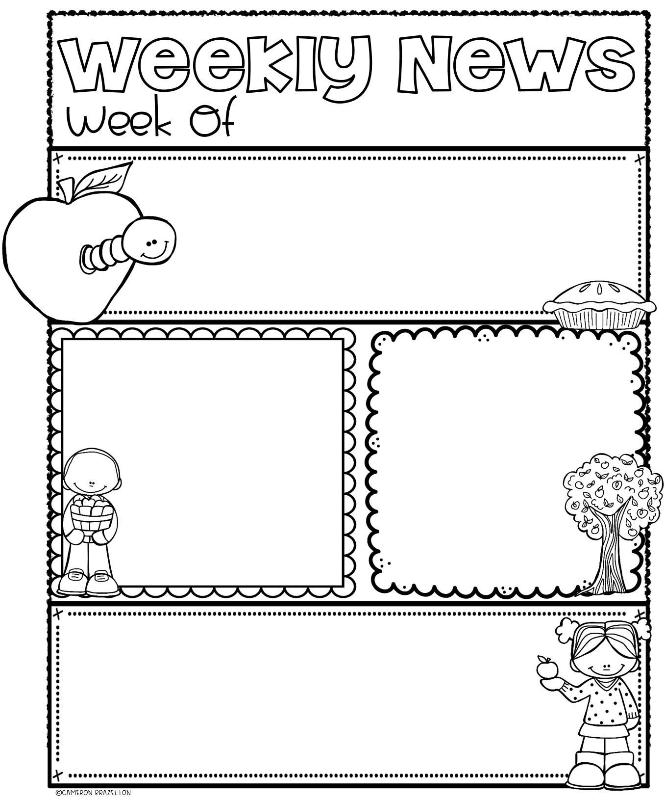
September 23 - 27
JOHNNY APPLESEED DAY!!
Friday, September 27 is Johnny Appleseed Day. We will be doing an entire day filled with apple activities. We will investigate apples, try applesauce, learn about Johnny Appleseed, and read apple stories.
READING
MATH
Our class will continue to work on letters and sounds. By the end of this week, your child will have learned the letters Aa, Bb, Cc, Dd, Ee, Ff, Gg, Hh, Ii, Jj, Kk, Ll, Mm, Nn, Oo, Pp. We will be reviewing the high-frequency word: I and learning: can They will also learn proper book handling.
This week, our class will be learning the numbers 0, 1, 2, 3, & 4. Your child will learn the many ways to represent those numbers. You will see homework coming home working on these numbers as well.
ENRICHMENT SCHEDULE & REMINDERS
Monday: Library
Wednesday: Computer
Friday: Gym (dress down and wear sneakers)
*I will be going on vacation. I leave half day on Thursday and I will be returning on October 9. Please sign up for Remind if you haven’t done so already so that you can get in touch with me if need be while I am away.
I will be sending my students videos throughout my trip to let them know
that I am thinking of them.

